Slide 1
BERT

Slide 2
Classical BERT (Bidirectional Encoder Representations from Transformers) is a transformer-based encoder model introduced by Google AI in 2018.

Slide 3
Architecture
BERT uses:
Token Embeddings
Segment Embeddings
Positional Embeddings
Multi-head self-attention
Feed-forward layers

Slide 4
Worked Numerical Example (2 tokens, 2D vectors)
Sentence: “good movie”
Position | Vector
0 | [0.1, 0.1]
1 | [0.1, 0.2]
2 | [0.1, 0.3]
Token | Embedding
good | [1, 0]
movie | [0, 1]
[CLS] | [1, 1]

Slide 5
Step 1 — Add Positional Embeddings
Final input embeddings:
[CLS]:
[1,1]+[0.1,0.1]=[1.1,1.1]
good:
[1,0]+[0.1,0.2]=[1.1,0.2]
movie:
[0,1]+[0.1,0.3]=[0.1,1.3]

Slide 6
Step 2 — Self-Attention
compute:
W_{Q​}=W_{K​}=W_{V​}=Identity

Slide 7
Step 3 — Compute Attention Scores for [CLS]
Dot products with all tokens:
[CLS] • [CLS]:
(1.1)(1.1)+(1.1)(1.1)=2.42
[CLS] • good:
(1.1)(1.1)+(1.1)(0.2)=1.43
[CLS] • movie:
(1.1)(0.1)+(1.1)(1.3)=1.54
So attention logits:
[2.42, 1.43, 1.54]

Slide 8
Step 4 — Scale
d_{k}=2 =Sqrt(2) = 1.414
Scaled:
[2.42/1.414 , 1.43/1.414, 1.54/1.414]
[1.71, 1.01, 1.09]

Slide 9
Step 5 — Softmax
Exponentiate:
e^{1.71}=5.53
e^{1.01}=2.74
e^{1.09}=2.97
Sum:
11.24
Attention weights:
[0.49, 0.24, 0.26]

Slide 10
Step 6 — Weighted Sum (New CLS)
0.49[1.1,1.1]+0.24[1.1,0.2]+0.26[0.1,1.3]
Compute:
First dimension:
0.539+0.264+0.026=0.829
Second dimension:
0.539+0.048+0.338=0.925
New CLS representation:
[0.829, 0.925]

Slide 11
Step 7 — Classification Layer
Assume binary sentiment classifier:
W=[1,1]
Logit:
0.829+0.925=1.754
Apply sigmoid:
σ(1.754)=0.852
So probability of Positive = 85.2%

Slide 12
Sentence-BERT (SBERT)

Slide 13
Sentence-BERT (SBERT)
SBERT was introduced by Nils Reimers and Iryna Gurevych (2019).
modification of the pretrained BERT network that use siamese and triplet network structures to derive semantically meaningful sentence embeddings that can be compared using cosine-similarity.
Originally, with BERT, finding the most similar pair in a collection of 10,000 sentences requires about 50 million inference computations (~65 hours).
SBERT reduces the similarity search time to about 5 seconds.
SBERT adds a pooling operation to the output of BERT / RoBERT to derive a fixed sized sentence embedding.

Slide 14
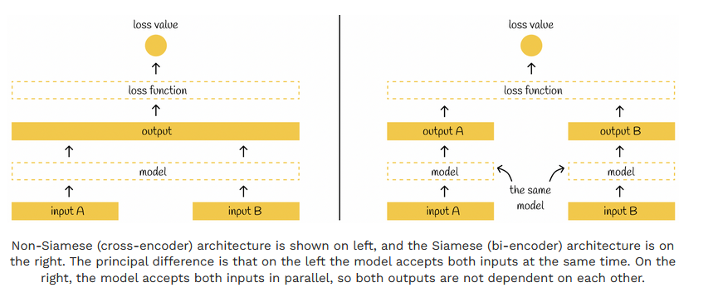
Non- siamese Vs Siamese

Slide 15
Working of SBERT
after passing a sentence through BERT, a pooling layer is applied to BERT embeddings to get their lower dimensionality representation:
initial 512 768-dimensional vectors are transformed to a single 768-dimensional vector.
For the pooling layer, SBERT authors propose choosing a mean-pooling layer as a default one, though they also mention that is possible to use the max-pooling strategy or simply to take the output of the [CLS] token instead.
When both sentences are passed through pooling layers, we have two 768-dimensional vectors u and v.

Slide 16
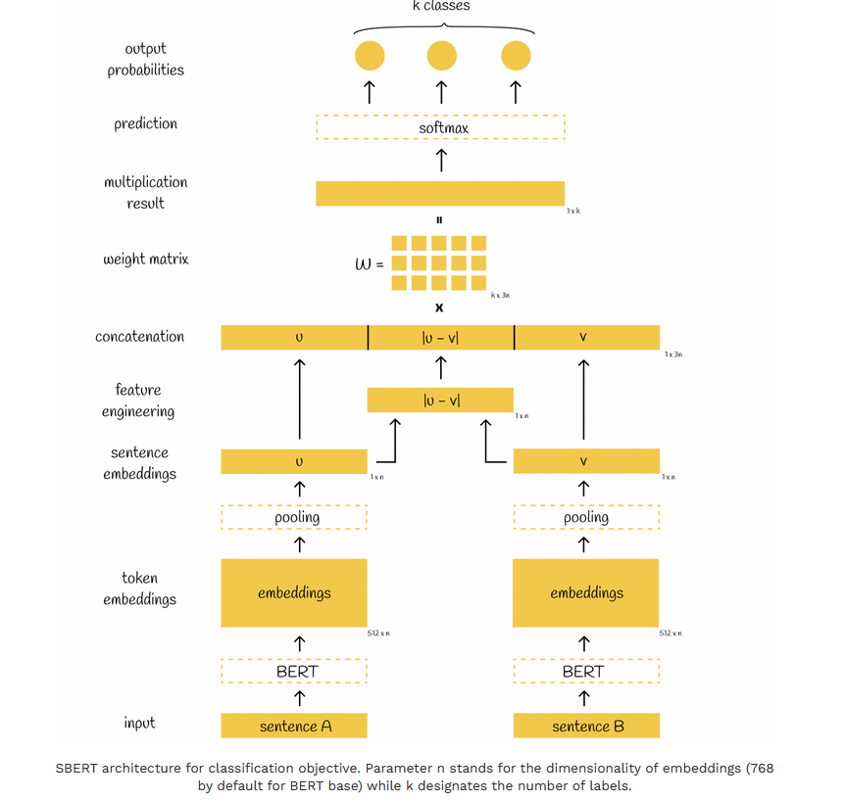

Slide 17
SBERT model
originally trained on two datasets SNLI and MultiNLI which contain a million sentence pairs with corresponding labels entailment, contradiction or neutral.
fine-tune SBERT with a 3-way softmax-classifier objective function for one epoch. uses a batch-size of 16, Adam optimizer with learning rate 2e−5, and a linear learning rate warm-up over 10% of the training data. The default pooling strategy is mean.

Slide 18
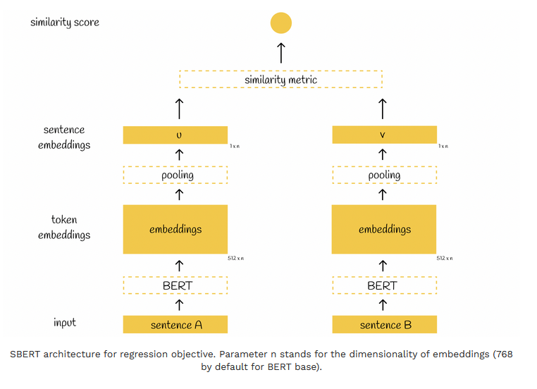
Similarity Score : Regression objective function

Slide 19
CosineSimilarity(u,v)=
​
Pooling methods:
Mean pooling (most common)
CLS pooling
Max pooling

Slide 20
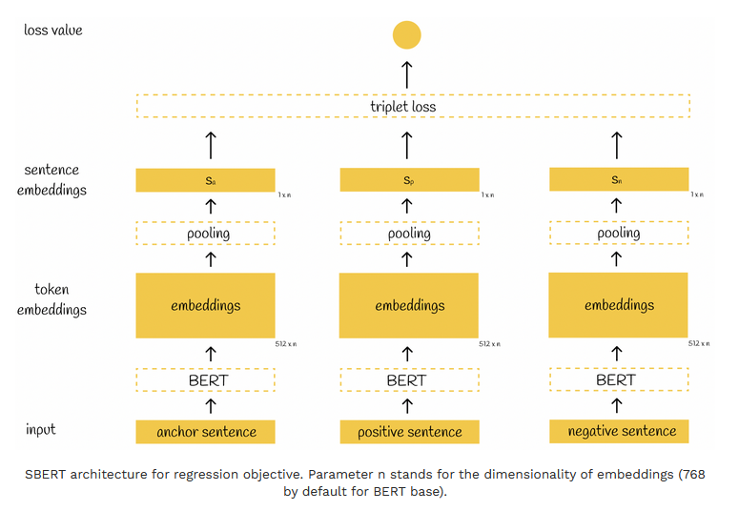
Triplet objective function

Slide 21

Triplet objective function
triplet loss which is calculated on three sentences usually named anchor, positive and negative.
It is assumed that anchor and positive sentences are very close to each other while anchor and negative are very different.
During the training process, the model evaluates how closer the pair (anchor, positive) is, compared to the pair (anchor, negative).
Variables sₐ, sₚ, sₙ represent anchor, positive and negative embeddings respectively. Symbol ||s|| is the norm of the vector s. Parameter ε is called margin.

Slide 22
Example
Example
Step 1: Tokenization (Simplified)
S1: “I love machine learning”
S2: “I enjoy studying AI”
S1 tokens:
[I, love, machine, learning]
S2 tokens:
[I, enjoy, studying, AI]

Slide 23
Step 2: BERT Embeddings
Sentence 1 Token Embeddings:
Sentence 2 Token Embeddings:
Token | Vector
I | (1, 0, 1)
love | (2, 1, 0)
machine | (1, 1, 1)
learning | (2, 2, 1)
Token | Vector
I | (1, 0, 1)
enjoy | (2, 1, 0)
studying | (1, 2, 1)
AI | (2, 1, 2)

Slide 24
Step 3: Mean Pooling
Sentence 1 embedding:
Sentence 2 embedding:
[(1,0,1)+(2,1,0)+(1,1,1)+(2,2,1)​]/4
Sum:
(6, 4, 3)
Mean:
S1 = (6/4, 4/4, 3/4)
S1 = (1.5, 1, 0.75)
Sum:
(1+2+1+2, 0+1+2+1, 1+0+1+2)
= (6, 4, 4)
Mean:
S2 = (6/4, 4/4, 4/4)
S2 = (1.5, 1, 1)

Slide 25
Step 4: Cosine Similarity
Dot product:
(1.5×1.5)+(1×1)+(0.75×1)
= 2.25 + 1 + 0.75
= 4
Magnitude:
||S1|| = √(1.5² + 1² + 0.75²)
= √(2.25 + 1 + 0.5625)
= √3.8125 ≈ 1.95
||S2|| = √(1.5² + 1² + 1²)
= √(2.25 + 1 + 1)
= √4.25 ≈ 2.06
Cosine similarity:
= 4 / 4.017
≈ 0.996
Interpretation
Similarity ≈ 0.996
→ Very high similarity
→ Sentences are semantically similar.

Slide 26
Key Difference: Classical BERT vs Sentence-BERT
Classical BERT | Sentence-BERT
Designed for token-level tasks | Designed for sentence embeddings
Needs pair input for similarity | Encodes independently
Slow for retrieval | Fast for retrieval
Uses CLS for classification | Uses mean pooling

Slide 27
SBERT Natural Language Interface

Slide 28
Example
Example
Step 1: Siamese SBERT Encoder
Sentence A:
"A man is playing guitar"
Sentence B:
"A person is performing music"
Label: Entailment
We assume 3 classes:
0 → Contradiction
1 → Neutral
2 → Entailment
Both sentences pass through SBERT
Assume output embeddings are 3-dimensional (real = 768).
Let:
u=(1,2,3)
v=(1,1,2)

Slide 29
Step 2: Feature Construction
Step 3: Linear Classification Layer
SBERT for classification typically uses:
h=[u;v;∣u−v∣]
Compute |u − v|
u−v=(1−1,2−1,3−2)
=(0,1,1)
So:
h=(1,2,3,1,1,2,0,1,1)
Final feature vector dimension = 9
Apply : z=Wh+b
Assume: W is 3×9 matrix (3 classes)
Let:
Assume bias b = (0,0,0)

Slide 30
Step 4: Compute Logits
Class 0:
Class 1:
Multiply first row with h:
= (1×1) + (0×2) + (1×3)+ (0×1) + (1×1) + (0×2) + (1×0) + (0×1) + (1×1)
= 1 + 0 + 3 + 0 + 1 + 0 + 0 + 0 + 1
= 6
= (0×1) + (1×2) + (0×3) + (1×1) + (0×1) + (1×2) + (0×0) + (1×1) + (0×1)
= 0 + 2 + 0 + 1 + 0 + 2 + 0 + 1 + 0
= 6

Slide 31
Step 4: Compute Logits
Class 2:
= (1×1) + (1×2) + (0×3) + (0×1) + (1×1) + (1×2) + (0×0) + (0×1) + (1×1)
= 1 + 2 + 0 + 0 + 1 + 2 + 0 + 0 + 1
= 7
logits:
z=(6,6,7)

Slide 32
Step 5: Softmax
Compute exponentials:
e⁶≈403.4
e⁷≈1096.6
Sum:
403.4+403.4+1096.6=1903.4
Class 0:
403.4/1903.4≈0.21
Class 1:
403.4/1903.4≈0.21
Class 2:
1096.6/1903.4≈0.58

Slide 33
Step 6: Prediction
Step 7: Cross-Entropy Loss
Highest probability = Class 2
→ Entailment
Correct prediction.
True label = 2
Loss=−log(0.58)
≈0.54
That loss is backpropagated through:
Linear layer
Feature combination
Both BERT encoders (shared weights)

